Slide 1

STUDENT RECORD MANAGEMENT SYSTEM
By:
Saisree E (46282521)
Vidyalakshmi D B (46282522)
Umajyothi Yeleti(46282336)
Mutyala Tharaka Saieswari(46282335)

Slide 2
CONTENT
Introduction
Requirements
Problem Statements
Functional Specifications
Technical Specifications
Flow chart
ER Diagram
Use Case Diagram
Sequence Diagram
Modules
Technologies Used
Benefits
Conclusion

Slide 3
INTRODUCTION
A student record management software is a tool that tracks and records the details of students in institutes including their exam performance and their personal information which can be easily searched and retrieved later on.
The software stores years of data online without hampering their functioning. The software helps to generate reports easily in required formats.
The system can help users to find and retrieve student’s data over a few clicks. The is easy to use and paperless system.

Slide 4
REQUIRMENTS
Problem Statement.
Functional Specifications.
Technical Specifications.

Slide 5
PROBLEM STATEMENT
The proposed solution is to design and develop a student record management system.
The system will contain an admin that will add, delete, modify, search and display the student records.
The system will replace the paper system into a digital system which would not require any hard copies and physical space for record keeping. The system will serve as the centralized database for all the records in the entire student process. The system is easy and convenient to use.

Slide 6
FUNCTIONAL REQUIRMENTS
• All records are saved in a file.
• Key features of the system are:
Login as admin: there exists only one admin for the system
Perform the operations such as add, delete, search, modify and display the students record.

Slide 7
TECHNICAL SPECIFICATION
• Data validation is done for username, password, email id, phone number, roll no, gender,
stream and age.
• Write optimized logic for searching as time complexity should not get increased while
searching any information.
• For this we can store all the data in a file.

Slide 8
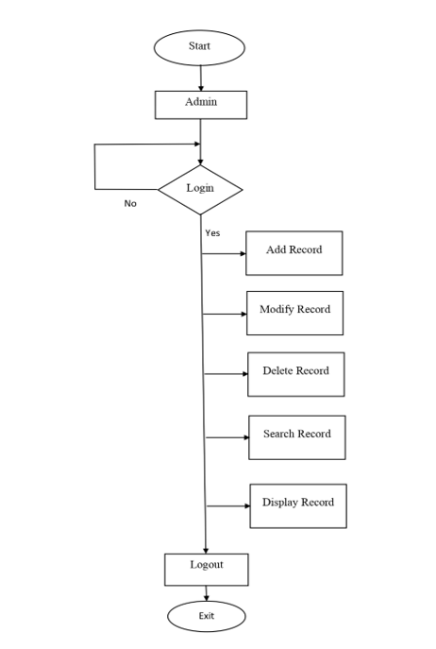
FLOWCHART

Slide 9
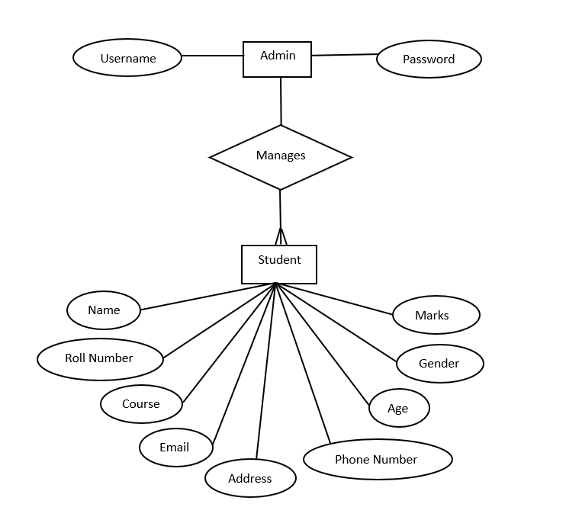
ER DIAGRAM

Slide 10
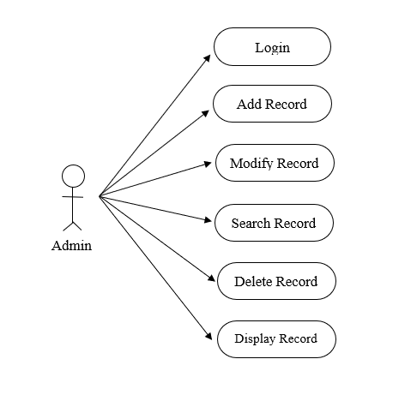
USECASE DIAGRAM

Slide 11
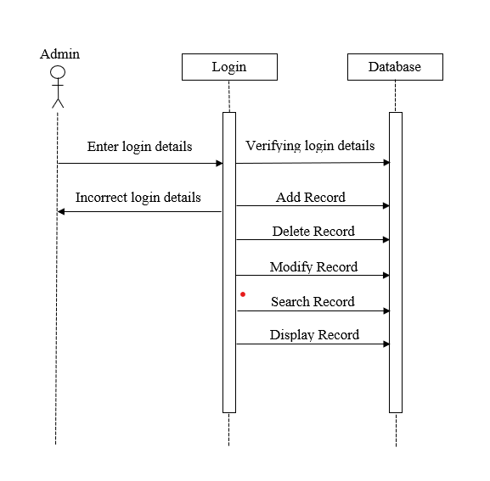
SEQUENCE DIAGRAM

Slide 12
ADMIN MODULE
Admin manages the entire system.
Admin can perform the operations such as add, delete, modify, search and display students record.

Slide 13
DATA VALIDATION MODULE
Data validation is the process of verifying and validating data that is collected before it is used.
Any type of data handling task, whether it is gathering data, analysing it, or structuring it for presentation, must include data validation to ensure accurate results.
In the proposed system, data validation is done for username, password, email id, phone number, roll no, gender, stream and age.

Slide 14
TECHNOLOGIES USED
C++
C++ is a general-purpose programming language and is widely used nowadays for competitive
programming. It has imperative, object-oriented and generic programming features. C++ runs on
lots of platforms like Windows, Linux, Unix, Mac etc.
Linux
Linux is a Unix-like, open source and community-developed operating system (OS) for computers,
servers, mainframes, mobile devices and embedded devices. An operating system is the software
that directly manages a system's hardware and resources, like CPU, memory, and storage.

Slide 15
BENEFITS
Automation of entire process
Saves time
Accessibility.

Slide 16
TOOLS USED
g++
Makefile
Valgrind
Splint
cpplint
vim editor

Slide 17
CONCLUSION
Student Information Management System can be used by education institutes to maintain the records of students easily.
Achieving this objective is difficult using a manual system as the information is scattered, can be redundant and collecting relevant information may be very time consuming. All these problems are solved using this project.

Slide 18
THANK YOU

